Slide 1

Unity 2d Sharp
Let loose the Cat of War

Slide 2

Who
Jerel R Hass
agies1@Hotmail.com
@agies1

Slide 3
Thank You
Ryan Gilbert – For the Background and Foreground Art
Jesse Freeman – For the character Art and Template
@JesseFreeman
Weekend Code Project: Unity’s New 2D Workflow
https://gumroad.com/l/unity2d-platformer

Slide 4
What
You will
Subtract a D from the Universe
Make a World
Give and Take Life
Bend Science to your will
Herd Cat(s)
Harness the power of Light
Spawn an Endless army
Ask Many Questions
Leave

Slide 5
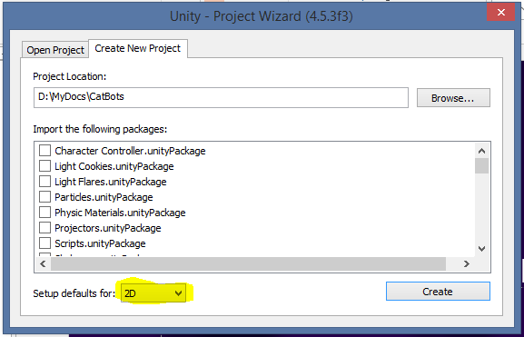
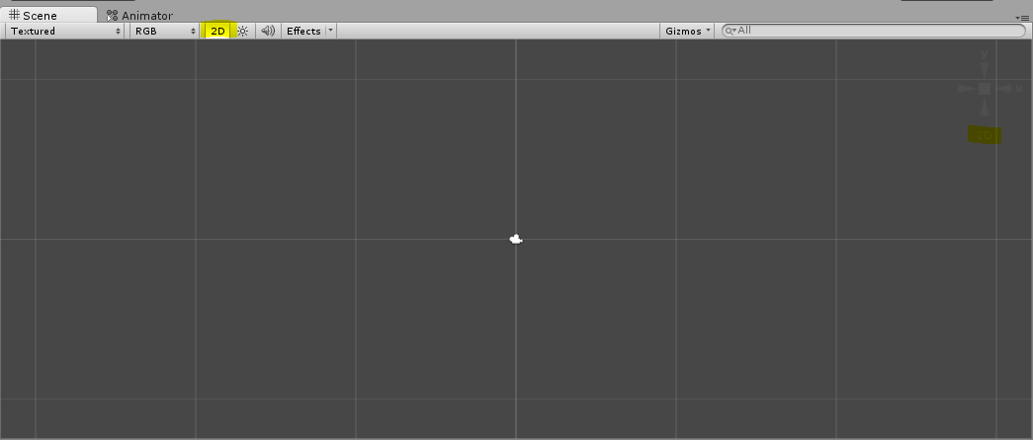
Subtracting a D
Start Unity while Holding ‘Alt’
Change 3d to 2d
Magic
Inside Unity
File
New Project
See Above

Slide 6
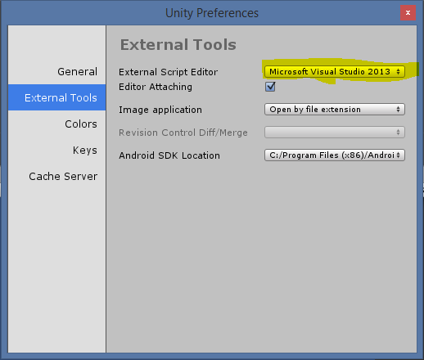
Hate the tool not the Developer
Edit
Preferences
External Tools

Slide 7
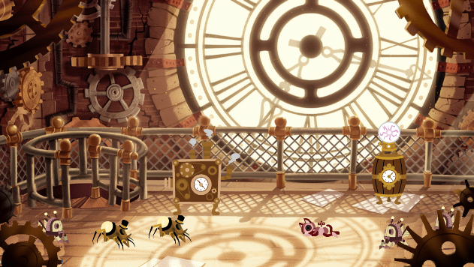
Make a World

Slide 8

Why is Everything so Blue?
We will be adding the following to our Project
Structure
Artwork
Scripts
Misc
Prefabs
Scenes
Art to the Artwork Folder
Code to the Scripts Folder

Slide 9
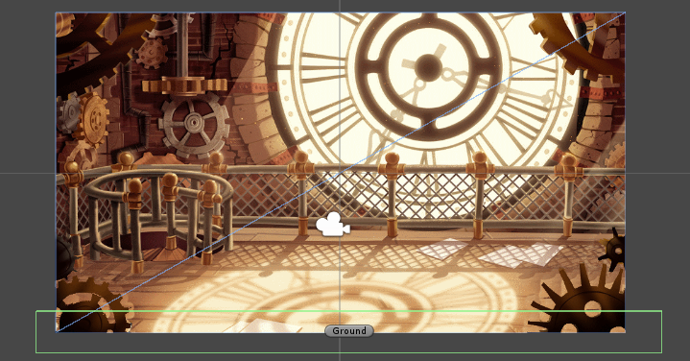
Banished Blue
Let us banish the blue we will add
A background
A Middle Ground
A Foreground
And Ground
Notes:
Add the Background -2
Add the Foreground 1
Add the Middleground -1
Add Sprite Called Ground

Slide 10

Give and Take Life
We are still missing something… Cats
Add A Robot Cat
Dissect the anatomy of the Cat
Reanimate the cat
Place the Cat into the world
Notes:
Drop the cat onto the Hierarchy
Examine the cat in the inspector
Splice Cat into pieces
Create an Animation for the cat
Add the Cat back into the Scene

Slide 11

Bend Science to Your Will
Ahhh… the Cat Defies the Law of Gravity
Teach the impudent Cat about science
Cats Should always land on their feet
Lazy Cat y u no move
Notes:
Add a Rigid Body 2D
Test
Add Box2D
Test
Add Box2D to ground
Create Physics Material, mo’ bounce
Test
Admonish cat

Slide 12
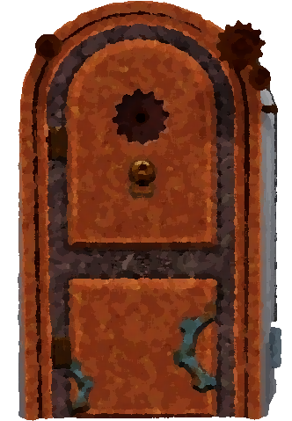



Herding A Cat
If the cat will not move on its own
Make the Cat Move
Teach the cat to not walk backwards
Notes:
Add Player Component to Cat
Test
Uncomment transform
Test
Make Sure Mobile is working!!
Add Blocker to sides

Slide 13
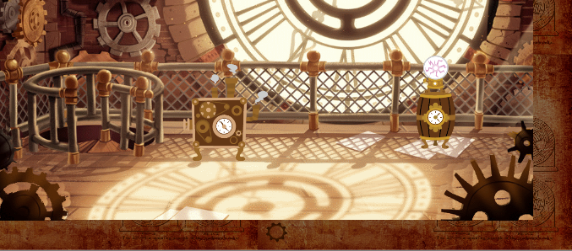
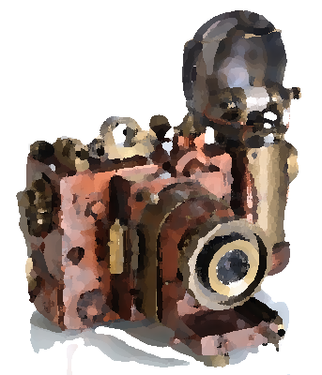

Harness the Power of Light
Just like in real life, everything should revolve around the cat
Make the Camera follow the cat around
!!!
Notes:
Add the Camera Follow to the Camera
Add Cat as Target
Adjust Y offset 1.5
Change Camera size to 3

Slide 14

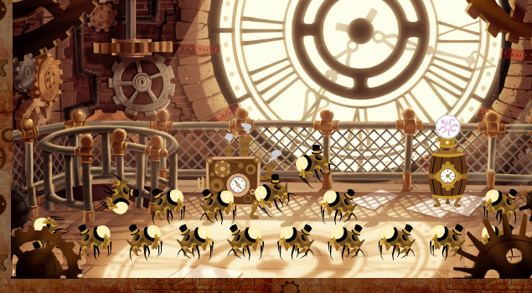
Spawn An Endless Army
Lazy Cat needs something to entertain it
Let us spawn an endless army of the vilest creature imaginable… Spiders
Not just any spiders, spiders with top hats!
That should entertain the cat
Notes:
Splice Spider
Add MoveFoward
Demonstrate Required Component
Add Box2D
Add RigidBody 2D
Show Dropped Spider
Enable Touching Code
Add Gizmo
Add Spawners
Add Mobs to Spawners
Keep Spiders from Colliding
Autodetect Spawners

Slide 15
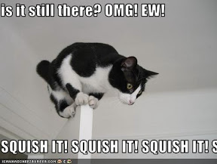
There will be blood, well oil
We can go ahead and get our creatures to fight now
Notes:
Add Health and Attack scripts
Run around and kill things
Add Death Sprites
Add Fade Away to Spites

Slide 16
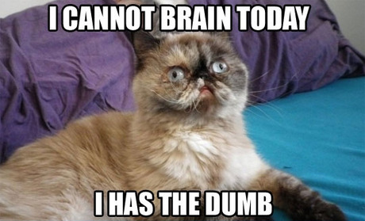
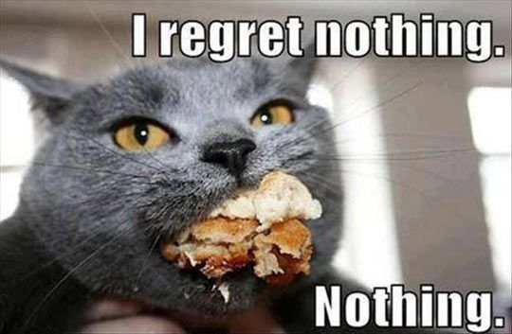

Questions?
I can only answer questions in the form of cat meme photos!

